Slide 1
CS601PC:MACHINE LEARNING

Slide 2
Textbook
Tom M. Mitchell
Machine Learning
McGraw-Hill, New York

Slide 3
Unit-1 chapter-2

Slide 4
CHAPTER-2 Concept learning and the General-to-specific ordering
CONTENTS:
Introduction
A concept learning task
Concept learning as search
Find-S:Finding a Maximally specific Hypotheses
Version spaces and the CANDIDATE-Elimination algorithm with remarks
Inductive bias

Slide 5
A CONCEPT LEARNING TASK
Concept learning means inferring a Boolean valued function from the training examples of its input & output.
An example learning task “ENJOY SPORT”: where a friend enjoys water sports or not??
Several attributes are present in this task like : sky, air temperature, humidity, wind, water forecast and also “enjoy sport”

Slide 6
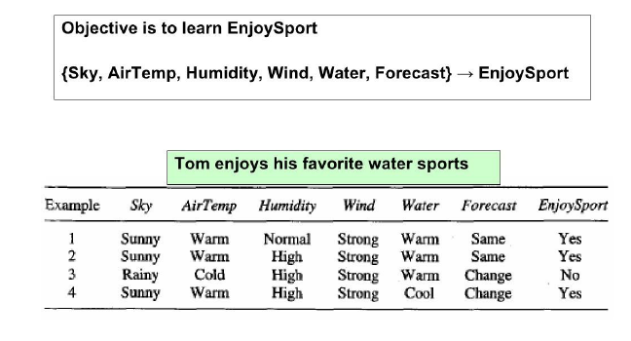
A CONCEPT LEARNING TASK

Slide 7
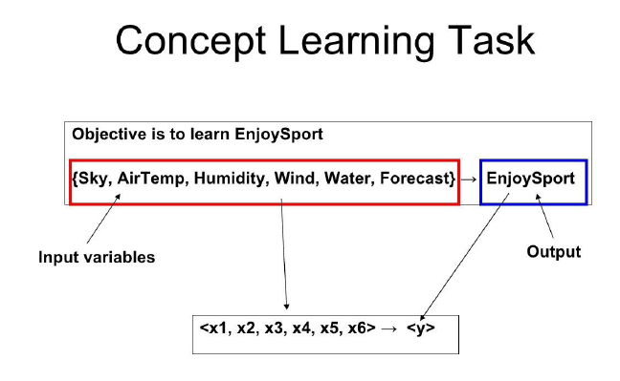

Slide 8
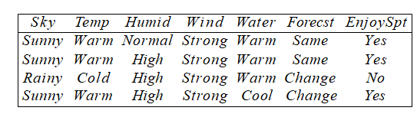
TRAINING EXAMPLES FOR ENJOYSPORT:
TASK: to predict “enjoy sport” of an arbitrary day based on other values of attributes
HYPOTHESIS REPRESENTATION:
Conjunction of constraints on the instance attributes.
Here, it’s a vector having 6 constraints i.e sky,temp,humid,wind,water and forecast.
For each attribute, Hypothesis will be:
“?” -→ any value is acceptable for this attribute
“Ø” -> no value is accptable
Specify a single value i.e required. Ex, warm.

Slide 9
A POSITIVE EXAMPLE:
if an instance ‘x’ satifies all constraints of hypothesis ‘h’ then ‘h’ classifies ‘x’ as a “positive example”.
=> h(x)=1
example:
(?, cold, high,?,?,?) means enjoys sport on a cold day with highhumidity
(?,?,?,?,?,?) means enjoys sports = yes on any day i.e everyday positive
(Ø, Ø, Ø, Ø, Ø, Ø) means none of the day is a positive example.

Slide 10
A TARGET CONCEPT:
enjoy sport : X -> {0,1}
TRAINING EXAMPLES:
D: POSITIVE & NEGATIVE examples of the target function.
DETERMINE:
A hypothesis “h” in H such that h(x)=c(x) for all the values of x in X.

Slide 11
A CONCEPT LEARNING TASK
Concept learning means inferring a Boolean valued function from the training examples of its input & output.
An example learning task “ENJOY SPORT”: where a friend enjoys water sports or not??
Several attributes are present in this task like : sky, air temperature, humidity, wind, water forecast and also “enjoy sport”

Slide 12
A CONCEPT LEARNING TASK

Slide 14
TRAINING EXAMPLES FOR ENJOYSPORT:
TASK: to predict “enjoy sport” of an arbitrary day based on other values of attributes
HYPOTHESIS REPRESENTATION:
Conjunction of constraints on the instance attributes.
Here, it’s a vector having 6 constraints i.e sky,temp,humid,wind,water and forecast.
For each attribute, Hypothesis will be:
“?” -→ any value is acceptable for this attribute
“Ø” -> no value is accptable
Specify a single value i.e required. Ex, warm.

Slide 15
A POSITIVE EXAMPLE:
if an instance ‘x’ satifies all constraints of hypothesis ‘h’ then ‘h’ classifies ‘x’ as a “positive example”.
=> h(x)=1
example:
(?, cold, high,?,?,?) means enjoys sport on a cold day with highhumidity
(?,?,?,?,?,?) means enjoys sports = yes on any day i.e everyday positive
(Ø, Ø, Ø, Ø, Ø, Ø) means none of the day is a positive example.

Slide 16
A TARGET CONCEPT:
enjoy sport : X -> {0,1}
TRAINING EXAMPLES:
D: POSITIVE & NEGATIVE examples of the target function.
DETERMINE:
A hypothesis “h” in H such that h(x)=c(x) for all the values of x in X.

Slide 17
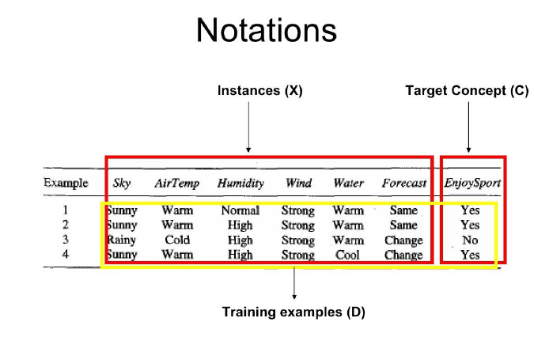

Slide 18
NOTATION:
INSTANCES: set of items over which the concept is defined is called “ set of instances”, X.
TARGET CONCEPT: the concept or the function to be learned is called target concept, C. it can be a boolean valued function defined over the instances X.
C:X->{0,1}
EX: in “ enjoy sport “ concept,
c(x)= 1 if enjoysport = yes
c(x)=0 if enjoysport = no.

Slide 19
NOTATION:
TRAINING EXAMPLES: when learning a target concept a learner is provided a set of training examples. They consists of instances x from X , along with this target concept value c(x).
If c(x) = 1 -> positive training example
If c(x)=0 -> negative training example
It is written in the form of ordered pair <x,c(x)> for defining a training example.
Where x= instance and c(x) is its target concept value.
The set of training set examples available is denoted as D.

Slide 20
NOTATION:
ALL POSSIBLE HYPOTHESIS:
denoted by H.
Using the set od training examples the learner must hypothesize or estimate C..
Each hypothesis in H is denoted by “h”which is a boolean value defined over X.
h: X->{0,1}
GOAL: FIND h such that h(x) = c(x) for all x in X

Slide 21
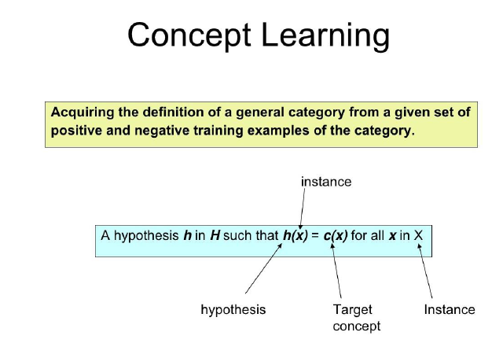

Slide 22
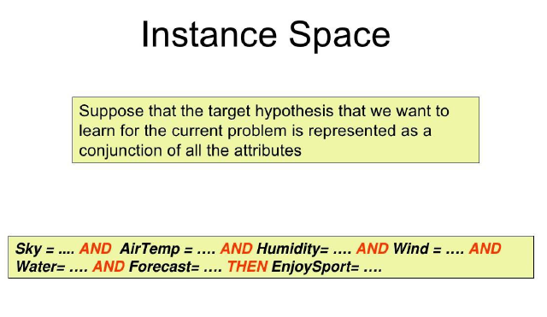
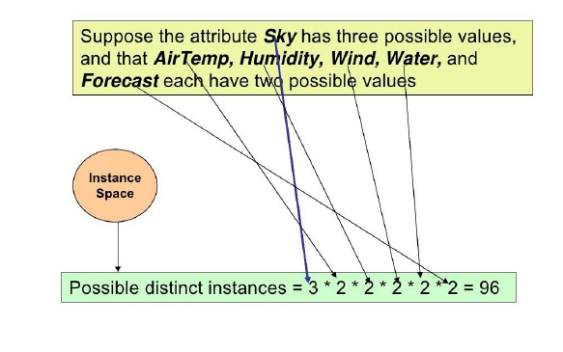

Slide 23
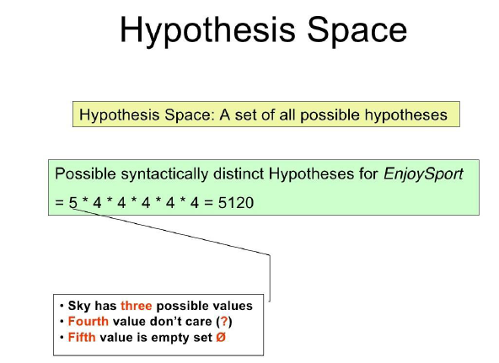

Slide 24
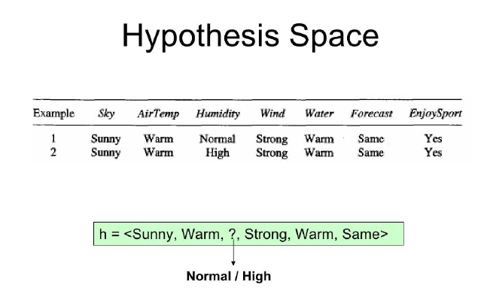
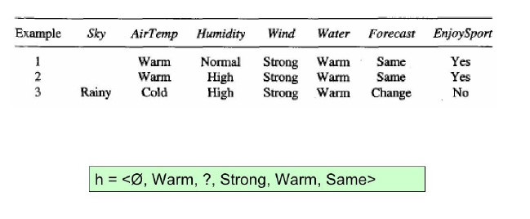

Slide 25
THE INDUCTIVE LEARNING HYPOTHESIS:
Any hypothesis found to approximate the target function well over a sufficiently large set of training examples will also approximate the target function well over other unobserved examples.

Slide 26
CONCEPT LEARNING AS SEARCH
Concept learning can be viewed as the task of searching through a large space of hypotheses implicitly defined by the hypothesis representation.
The goal of this search is to find the hypothesis that best fits the training examples.
In Enjoysport example number of instances of hypothesis are 5.4.4.4.4.4=5120 instances.
Most practical learning tasks involve much larger, sometimes infinite, hypothesis spaces.

Slide 27
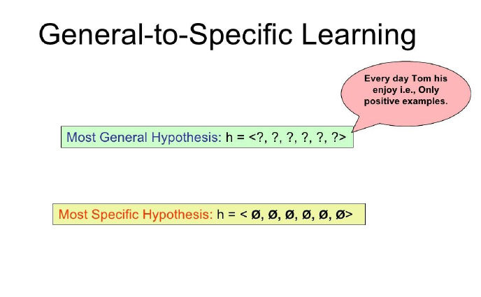

Slide 28
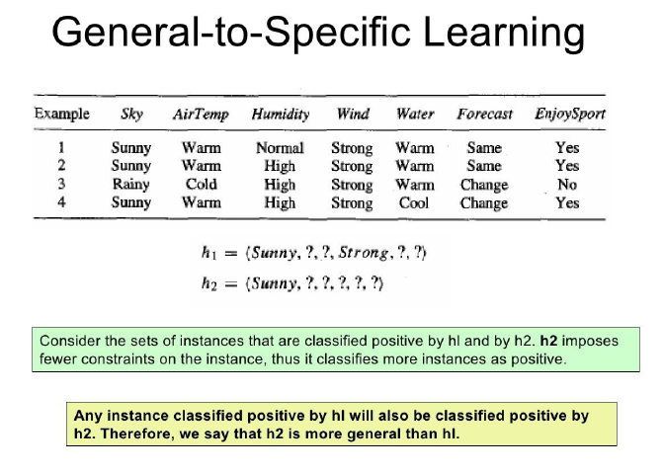

Slide 29
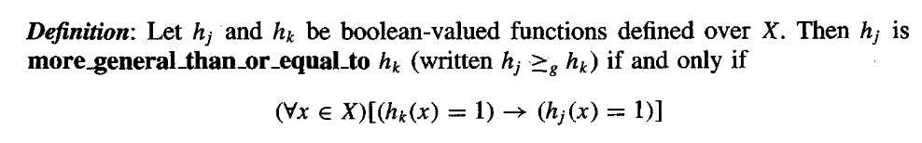
General-to-Specific Ordering of Hypotheses
h1=< sunny,?,?,strong,?,?>
h2=< sunny,?,?,?,?,?>
Both hypotheses are giving positive result, but then h2 is more general than h1.
(since h2 imposes fewer constraints on instance)

Slide 30
General-to-Specific Ordering of Hypotheses
Suppose if,
x- any instance
X- set of instances
h- any hypothesis
H- set of hypothesis
then, we say that x satisfies h iff h(x)=1.
Given 2 hypotheses hk and hj, if any instance satisfying hk also satisfies hj then hj is more general or equal to hk.
Strictly,then hj is more general than hk. (or) hk is more specific than hj.

Slide 31
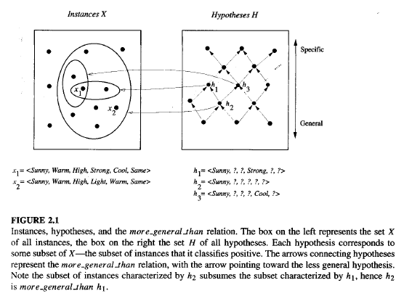
General-to-Specific Ordering of Hypotheses

Slide 32
FIND-S ALGORITHM
It is an application of more_general_than partial ordering.
It stands for FINDING A MAXIMALLY SPECIFIC ALGORITHM.

Slide 33
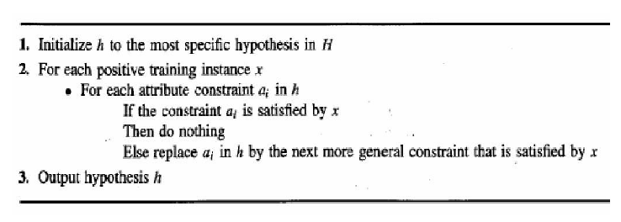
FIND-S ALGORITHM

Slide 34
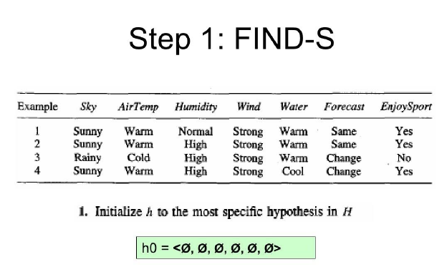
FIND-S ALGORITHM

Slide 35
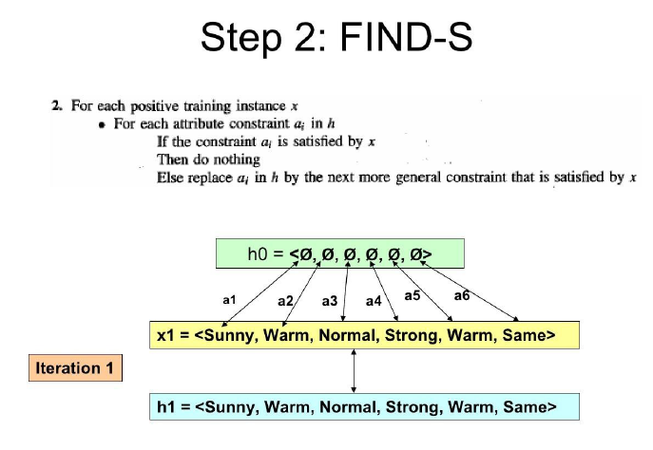
FIND-S ALGORITHM

Slide 36
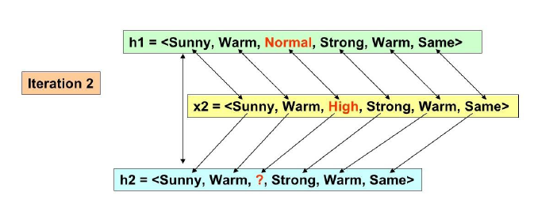
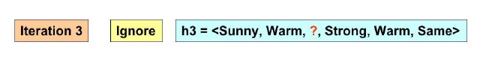
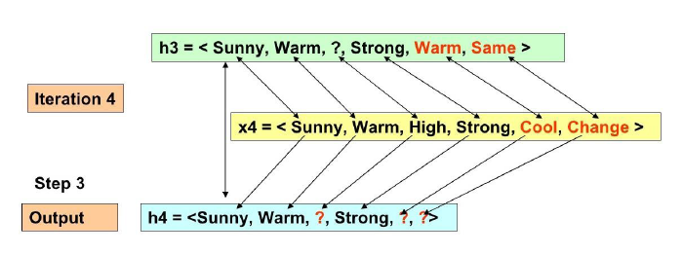
FIND-S ALGORITHM

Slide 37
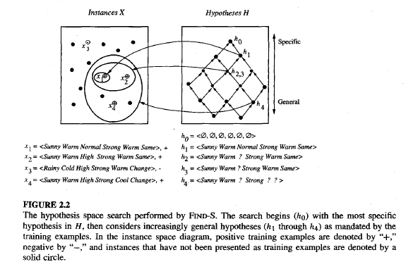
FIND-S ALGORITHM

Slide 38
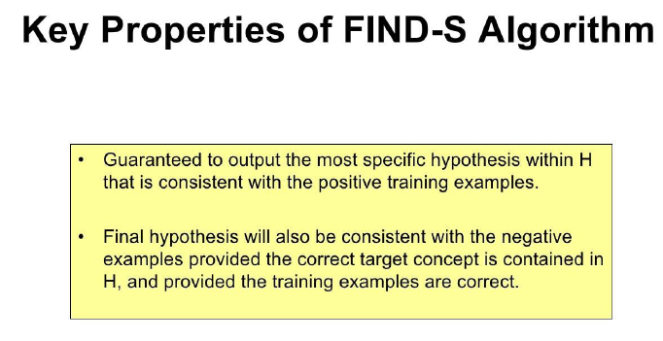
FIND-S ALGORITHM

Slide 39
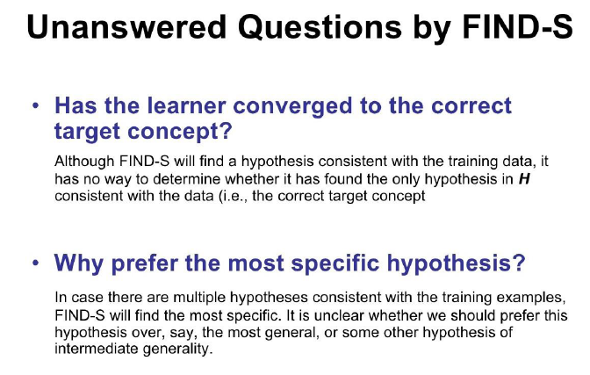
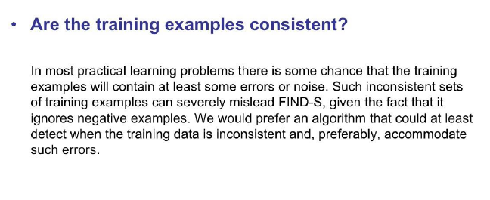
FIND-S ALGORITHM

Slide 40
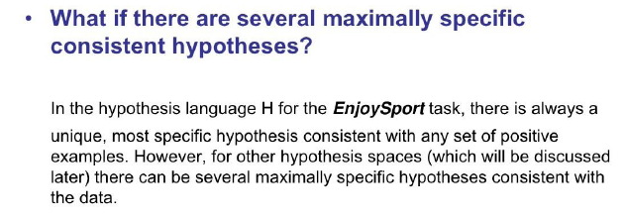
FIND-S ALGORITHM

Slide 41
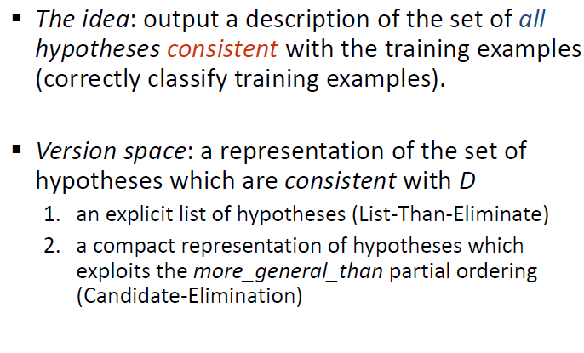
VERSION SPACES & CANDIDATE ELIMINATION ALGORITHM

Slide 42
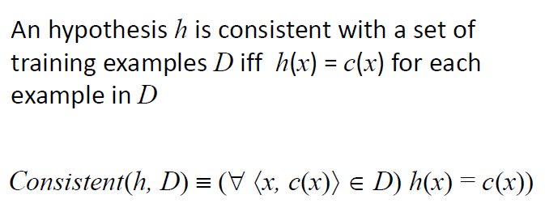
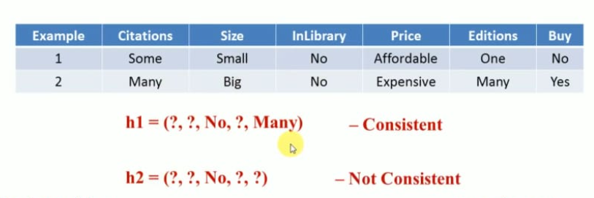
CONSISTENT

Slide 43
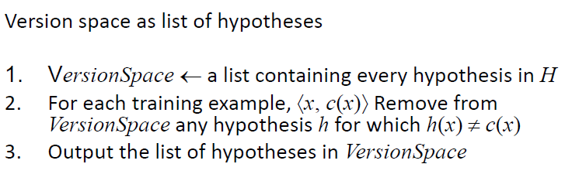
LIST - THEN – ELIMINATE ALGORTIHM

Slide 44
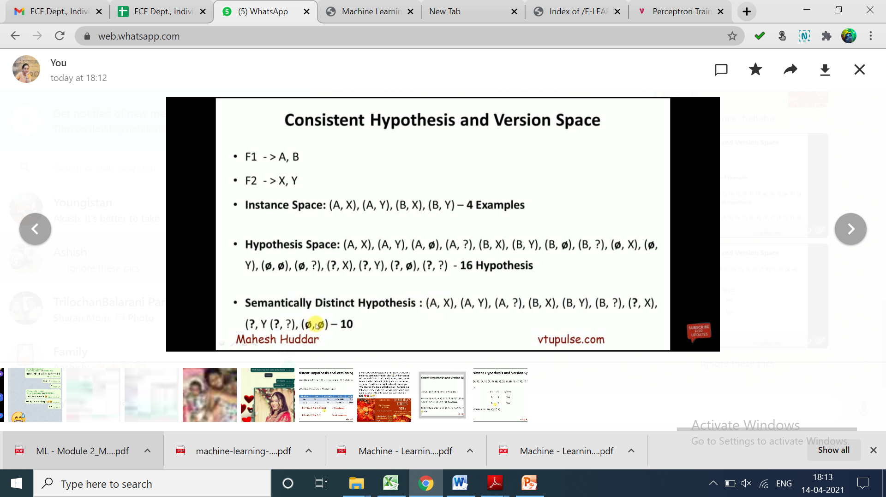
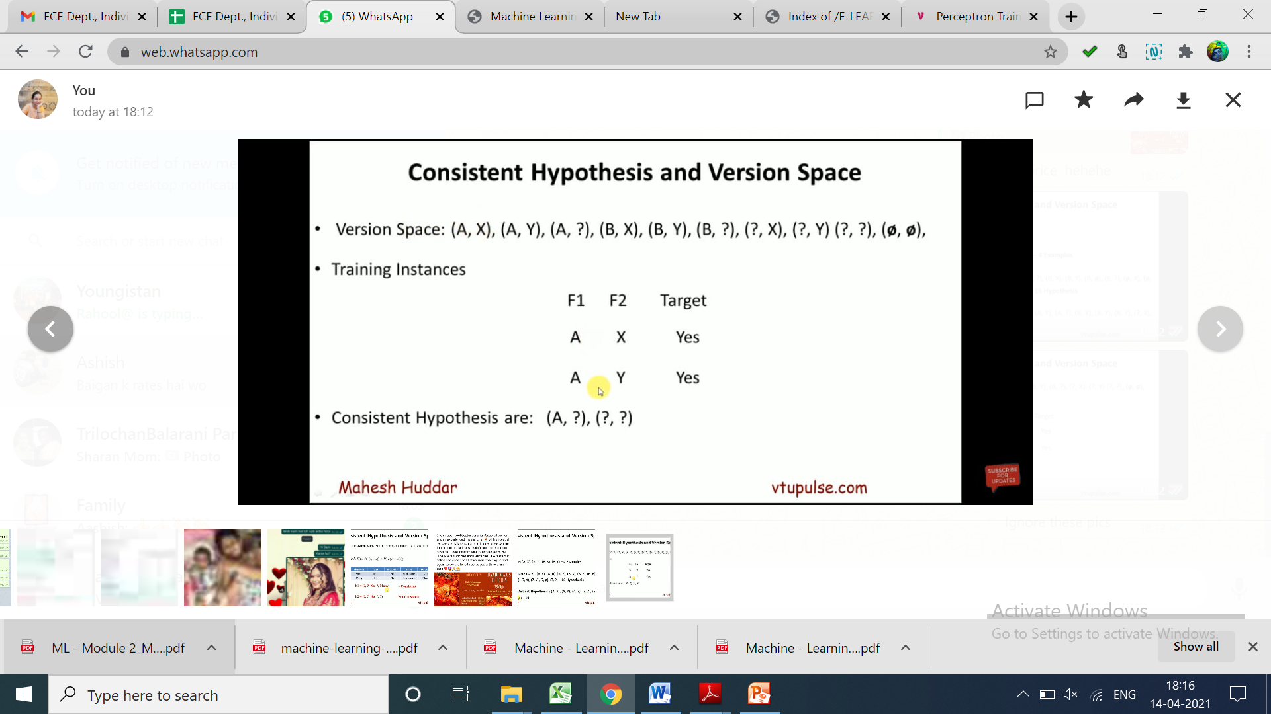
LIST - THEN – ELIMINATE ALGORTIHM CONSISTENT HYPOTHESIS & VERSION SPACE

Slide 45
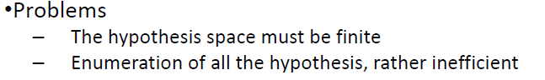
LIST - THEN – ELIMINATE ALGORTIHM

Slide 46
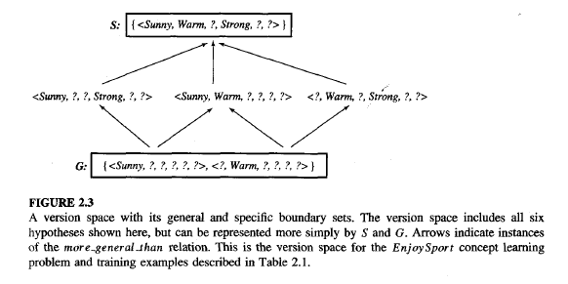
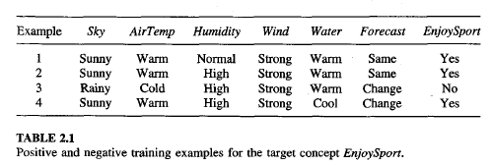
COMPACT REPRESENTATION FOR VERSION SPACES

Slide 47
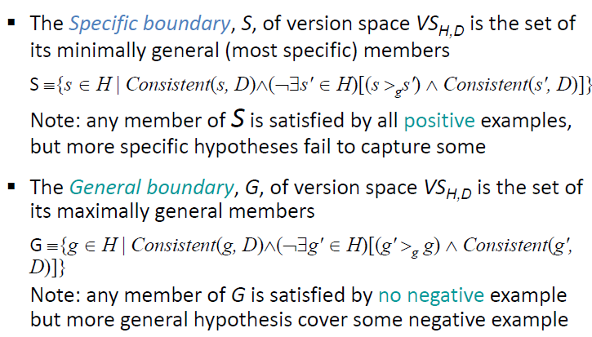
GENERAL AND SPECIFIC BOUNDARIES

Slide 48
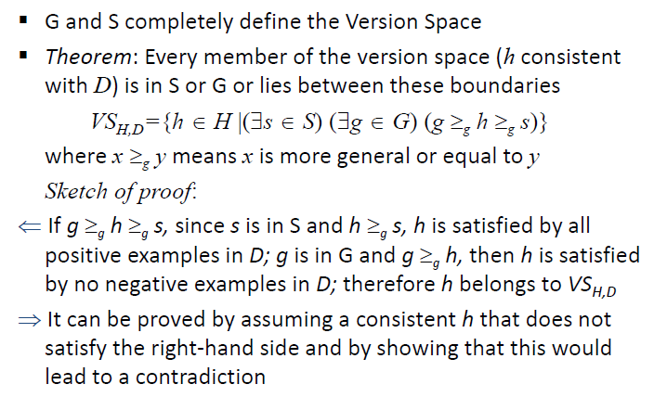
VERSION SPACE REPRESENTAION THEOREM

Slide 49
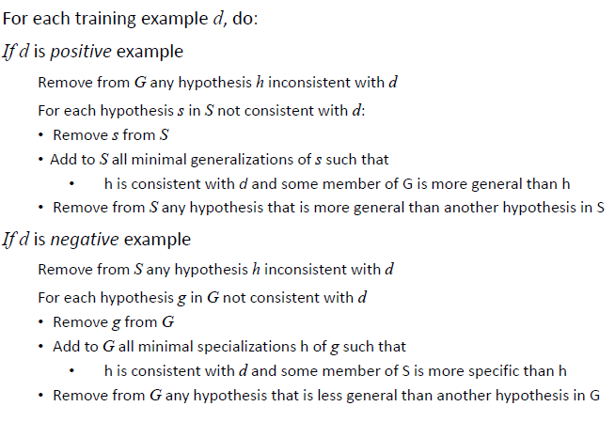
THE CANDIDATE_ELIMINATION ALGORITHM

Slide 50
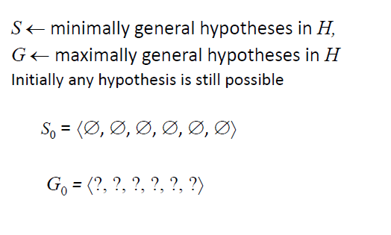
THE CANDIDATE_ELIMINATION ALGORITHM
Initialise G and S: S0 and G0 are initial boundary sets.

Slide 51
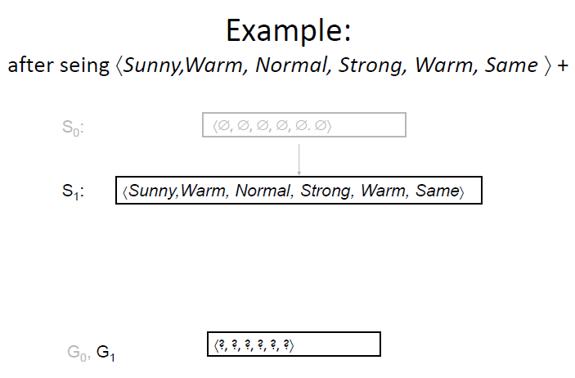
THE CANDIDATE_ELIMINATION ALGORITHM

Slide 52
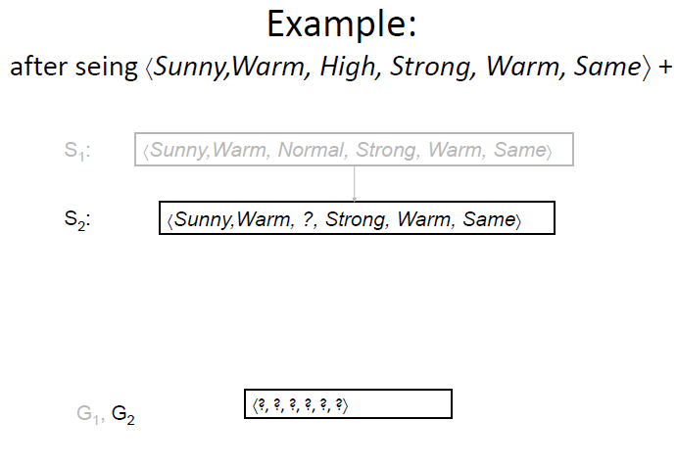

Slide 53
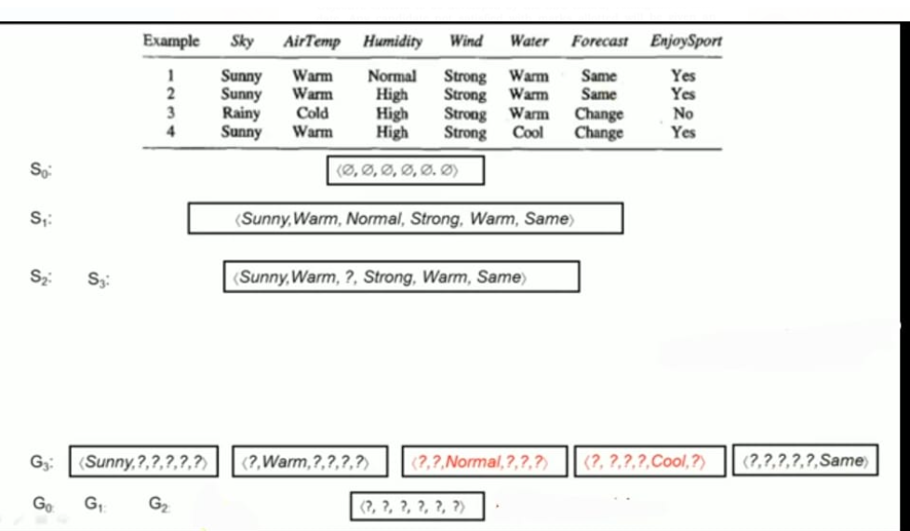
THE CANDIDATE_ELIMINATION ALGORITHM

Slide 54
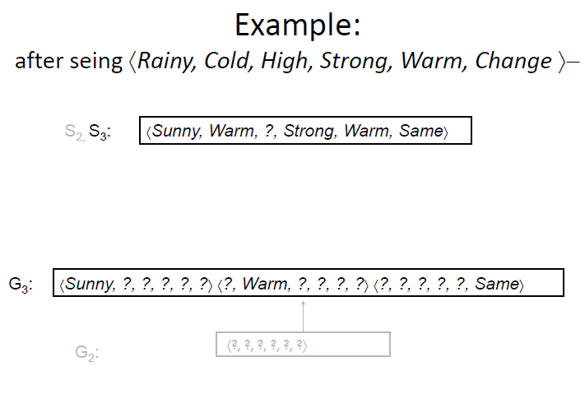
THE CANDIDATE_ELIMINATION ALGORITHM

Slide 55
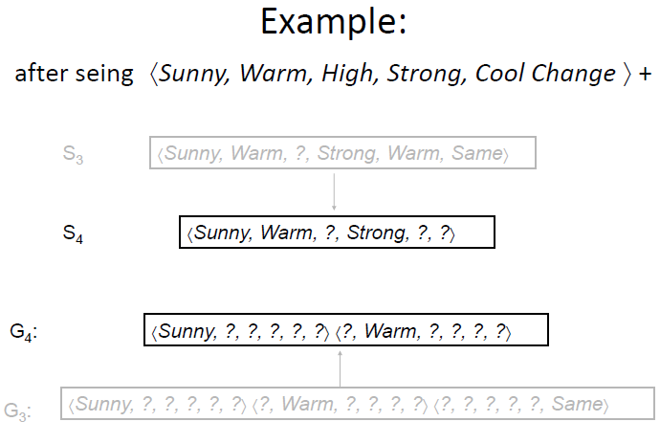

Slide 56
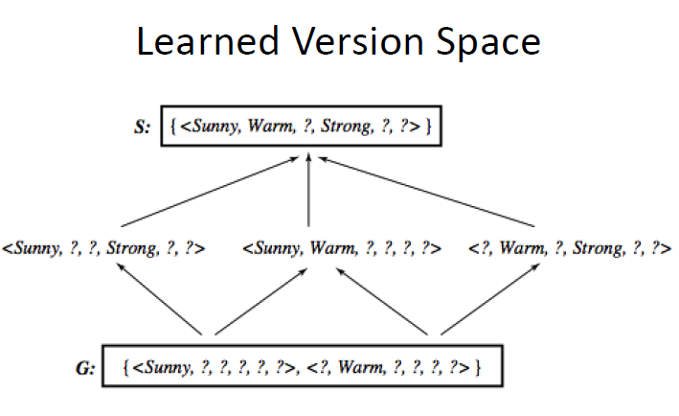
THE LEARNED VERSION SPACE

Slide 57
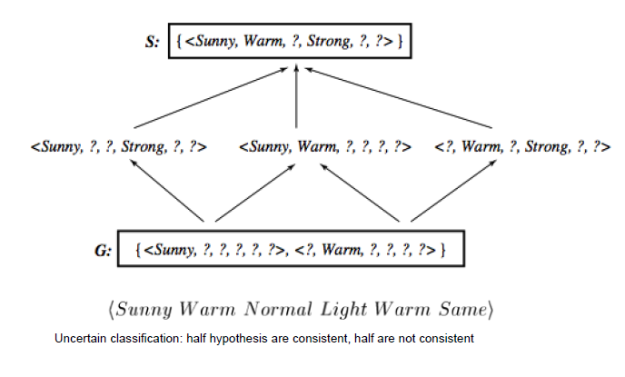
CLASSIFYING NEW EXAMPLES

Slide 58
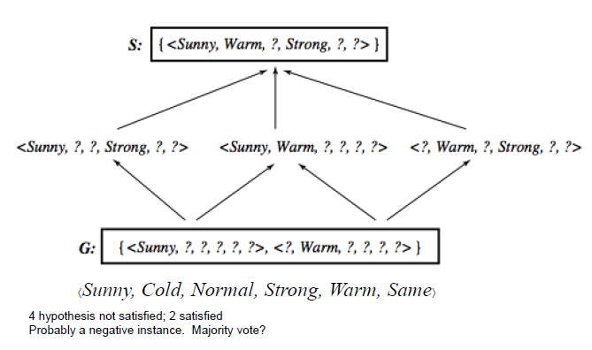
CLASSIFYING NEW EXAMPLES

Slide 59
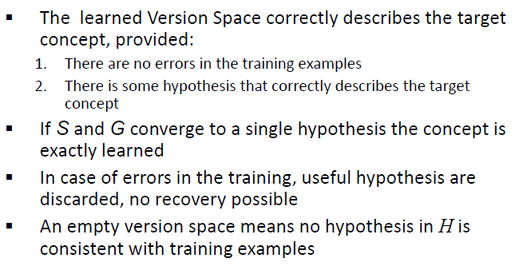
REMARKS ON VERSION SPACE & CANDIDATE_ELIMINATION

Slide 60
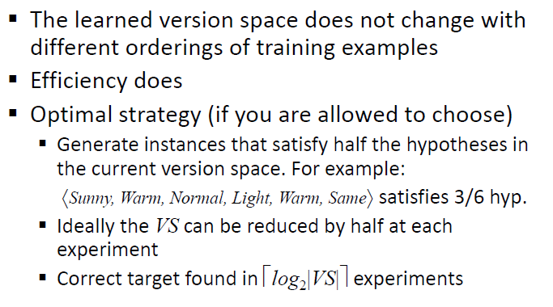
ORDERING ON TRAINING EXAMPLES

Slide 61
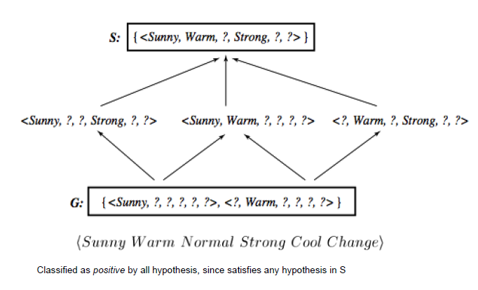
USE OF PARTIALLY LEARNED CONCEPTS

Slide 62
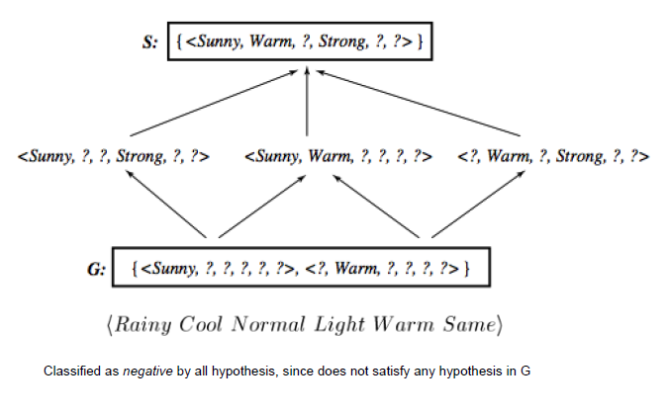
CLASSIFYING NEW EXAMPLES

Slide 63

HYPOTHESIS SPACE & BIAS

Slide 64

EXTENDING THE HYPOTHESIS SPACE

Slide 65

UNBIASED LEARNER

Slide 66

NO GENERALIZATION WITHOUT BIAS

Slide 67

NO INDUCTIVE INFERENCE WITHOUT A BIAS

Slide 68

INDUCTIVE BIAS

Slide 69

INDUCTIVE BIAS OF CANDIDATE_ELIMINATION

Slide 70

INDUCTIVE SYSTEM

Slide 71

EQUIVALENT DEDUCTIVE SYSTEM

Slide 72

EACH LEARNER HAS AN INDUCTIVE BIAS

